Slide 1
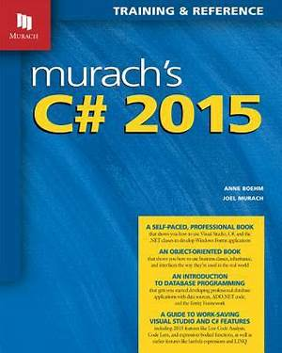
Programming
Lecture 9
Intro Event driven programming

Slide 2
Agenda
Event driven programming
Overview
Event types
Event Handlers
Event Example

Slide 3
Event driven programming
You learned to write code that runs sequentially. One line of code would execute, and then the next line, and the next line, and so forth.
However, what if you want to write blocks of code that execute in response to a certain event, like when a user clicks a button in your application?
This is called event-driven programming, and it will be the subject of this tutorial.

Slide 4
Event driven programming
Appropriately handling events is essential when developing desktop, mobile, and web applications. Event-driven programming allows you to write code that responds to specific events that are raised in your application.
Such events could be triggered by the application itself or by the user, such as when the user clicks a button or presses a key.

Slide 5
Event Overview
Events have the following properties:
The publisher determines when an event is raised; the subscribers determine what action is taken in response to the event.
An event can have multiple subscribers. A subscriber can handle multiple events from multiple publishers.
Events that have no subscribers are never raised.

Slide 6
Event Overview
Events have the following properties:
Events are typically used to signal user actions such as button clicks or menu selections in graphical user interfaces.
When an event has multiple subscribers, the event handlers are invoked synchronously when an event is raised. To invoke events asynchronously, see Calling Synchronous Methods Asynchronously.
In the .NET class library, events are based on the EventHandler delegate and the EventArgs base class.

Slide 7
Using Delegate with Event in C#
Events are declared and created in a class and are associated with the Event Handler by using Delegates inside
The class that contains the Event is used to publish that event, called the Publisher class.
Some other class that accepts this event is called the Subscriber class. Events in C# use the Publisher-Subscriber model.

Slide 8
Procedural programming vs.
event-driven programming
Procedural programming
Code is executed in procedural order
Event-driven programming
Code is executed upon activation of events

Slide 9
Event-related objects
Event source object
Where the action originates
Event object
Created from an event source
Event handler object
Processes the event
Event source
Event Object
Event Handle Object

Slide 10
Event sources
An event source is an object that can create an event
An event can be defined as a type of signal to the program that some external action has happened
For example
Button is event source
Button click action is the event it creates

Slide 11
Event
• An event is an object created from an event
source
• An event object contains whatever properties
are pertinent to the event

Slide 12
Event
•You can identify the source object of the event using the getSource() instance method in the EventObject
class
• The subclasses of EventObject deal with special types of events
Action Event
Mouse Event
Event Object
Event
Input Event
Key Event
Window Event

Slide 13
Mouse events
Click
This event occurs when the mouse button is released, typically before the MouseUp event. The handler for this event receives an argument of type EventArgs. Handle this event when you only need to determine when a click occurs.

Slide 14
Mouse events
MouseClick
This event occurs when the user clicks the control with the mouse. The handler for this event receives an argument of type MouseEventArgs. Handle this event when you need to get information about the mouse when a click occurs.

Slide 15
Mouse events
DoubleClick
This event occurs when the control is double-clicked. The handler for this event receives an argument of type EventArgs. Handle this event when you only need to determine when a double-click occurs.

Slide 16
Mouse events
MouseDoubleClick
This event occurs when the user double-clicks the control with the mouse. The handler for this event receives an argument of type MouseEventArgs. Handle this event when you need to get information about the mouse when a double-click occurs.

Slide 17
Mouse events
MouseDown
This event occurs when the mouse pointer is over the control and the user presses a mouse button. The handler for this event receives an argument of type MouseEventArgs.

Slide 18
Mouse events
MouseEnter
This event occurs when the mouse pointer enters the border or client area of the control, depending on the type of control. The handler for this event receives an argument of type EventArgs.

Slide 19
Mouse events
MouseHover
This event occurs when the mouse pointer stops and rests over the control. The handler for this event receives an argument of type EventArgs.

Slide 20
Mouse events
MouseLeave
This event occurs when the mouse pointer leaves the border or client area of the control, depending on the type of the control. The handler for this event receives an argument of type EventArgs.

Slide 21
Mouse events
MouseMove
This event occurs when the mouse pointer moves while it is over a control. The handler for this event receives an argument of type MouseEventArgs.

Slide 22
Mouse events
MouseUp
This event occurs when the mouse pointer is over the control and the user releases a mouse button. The handler for this event receives an argument of type MouseEventArgs.

Slide 23
Mouse events
MouseWheel
This event occurs when the user rotates the mouse wheel while the control has focus. The handler for this event receives an argument of type MouseEventArgs. You can use the Delta property of MouseEventArgs to determine how far the mouse has scrolled.

Slide 24
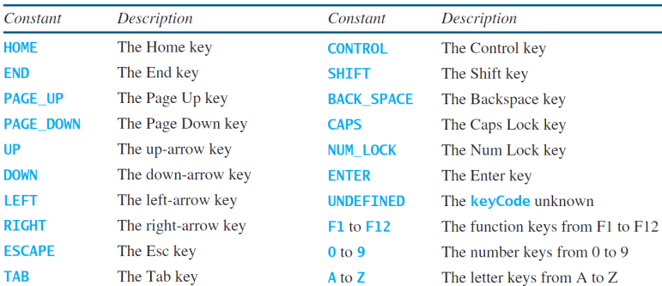
Key Constant
•Every key event has an associated code returned by the getCode() method in KeyEvent

Slide 25
Declare Events in C#
To declare an Event inside a class, a delegate type for that Event must first be declared. For example:
public delegate void BoilerLogHandler(string status);
Next, the Event itself is declared, using the event keyword in C#:
public event BoilerLogHandler Boiler EventLog;

Slide 26
Event Handlers
• Not all objects can handle events
• An object capable of handling an event is called an event handler
– The event handler processes the event
• An event handler must be an instance of an appropriate event-handling interface
• An event handler must be registered with an event source object

Slide 27
Event Handlers
• The event handler must be an instance of the EventHandler<T extends Event> interface
– <T extends Event> denotes that T is a generic type that is a subtype of Event
– This interface defines the common behavior for all handlers
• The EventHandler<ActionEvent> interface contains the handle(ActionEvent) method for processing the action event
– An event handler class must override this method to respond to the even

Slide 28
Event Handlers
• The EventHandler object handler must be registered with the event source object
source using the method source.setOnAction(handler)
• Firing an event means to create an event and delegate the handler to handle the event

Slide 29
Event Handlers
• The EventHandler<ActionEvent> interface contains the
handle(ActionEvent) method for processing the action event
• An event handler class must override this method to respond to the event

Slide 30
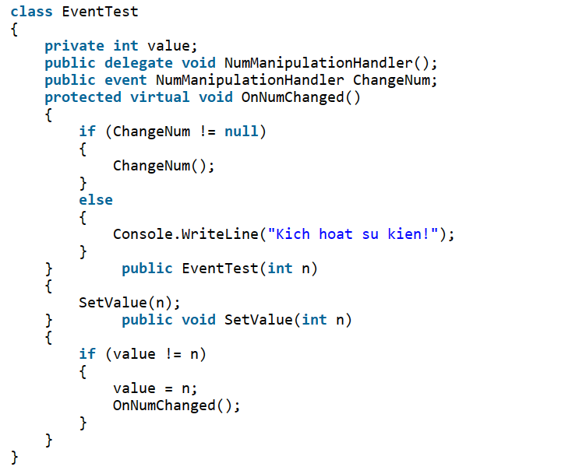
Declare Events in C#
Example 1.

Slide 31
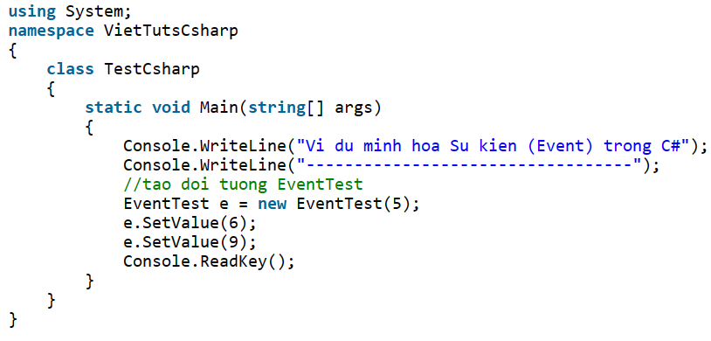
Declare Events in C#
Example 1.

Slide 32
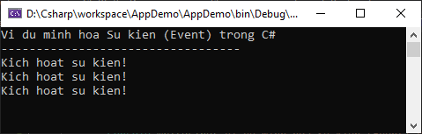
Declare Events in C#
If you do not use the Console.ReadKey(); then the program will run and terminate (so fast that you can't see the result). This command allows us to see the results more clearly.
Compiling and running the above C# program will give the following output:

Slide 33
Thank you!
Notes:
33

